Slide 1
Network Design and Management

Slide 2
Network Design:
Network desing is a crucial process in the creation of a computer network. It involves planning, implementing, managing, and maintaining the data communication infrastructure within an organization. A well-designed netwrok enables efficient data exchange, resource sharing, and seamless communication among devices,applications and users.

Slide 3
Component of Network Architecture:
Network architecture is the design and organization of computer networks, encompassing various components that work together to facilitate communication and data exchange. The key components of network architecture include:
Nodes:
Nodes are the devices or endpoints within the network where data is generated, processed, or consumed. Examples include computers, servers, routers, switches, and printers.
Links:
Links represent the physical or logical connections between nodes. Physical links can include cables, fiber optics, or wireless connections, while logical links define the paths data takes through the network.
Topology:
Topology refers to the layout or structure of the network, determining how nodes are connected. Common topologies include bus, star, ring, mesh, and hybrid configurations.

Slide 4
Protocols:
Protocols are a set of rules and conventions that govern how data is transmitted and received in a network. Examples include TCP/IP, HTTP, and DNS.
OSI Model Layers:
The OSI (Open Systems Interconnection) model divides network functions into seven layers, providing a conceptual framework for understanding network communication. These layers are physical, data link, network, transport, session, presentation, and application.
Networking Devices:
Various devices play specific roles in managing and directing data traffic. Common networking devices include routers, switches, hubs, bridges, and gateways.
IP Addressing:
IP addressing involves assigning unique numerical addresses to devices on a network, enabling them to be identified and communicate with each other. IPv4 and IPv6 are the main versions of the Internet Protocol.
Subnetting:
Subnetting divides a larger network into smaller subnetworks, enhancing efficiency, security, and manageability.

Slide 5
Firewalls and Security Measures:
Security components, such as firewalls, intrusion detection systems, and encryption protocols, protect the network from unauthorized access and cyber threats.
DNS (Domain Name System):
DNS translates human-readable domain names into IP addresses, facilitating user-friendly access to resources on the internet.
Virtualization:
Network virtualization allows the creation of multiple virtual networks on a single physical infrastructure, improving resource utilization and flexibility.

Slide 6
Wireless Networking:
Wireless technologies, such as Wi-Fi and Bluetooth, provide connectivity without the need for physical cables, supporting mobility and flexibility.
Quality of Service (QoS):
QoS mechanisms prioritize and manage network traffic to ensure that critical applications receive the necessary bandwidth and perform well.
Load Balancing:
Load balancing distributes network traffic across multiple servers or paths, ensuring optimal resource utilization and preventing bottlenecks.
Network Management Systems:
Network management tools monitor and control network resources, providing administrators with insights into performance, security, and configuration.
Cloud Services:
Cloud-based services offer scalable and on-demand resources, allowing organizations to leverage external infrastructure for storage, computing, and applications.

Slide 7
The Traditionl netwrok Design Process:
The traditional network design process involves a series of steps and considerations to create a computer netwrok that meets the organization's requirements efficiently and securely.
A Traditional netowrk design approach follows a structured systems analysis and design process similar to that building applications:
Network Analysis Phase:Meeting with users to determine the needs and applications.
Estimate data traffic on each part of the network and finally designing circuits needed to support this traffic and obtains cost estimates.
Implementation phase: In this phase building and implementing the network takes place 1 or 2 years.
Works well for static and slowly evolving netwroks,although costly and time consuming.

Slide 8
Building Block Network Design
While some organizations still use the traditional approach, many others use a simpler approach to network design, the building block approach.
This approach involves three phases: needs analysis, technology design, and cost assessment.
When the cost assessment is initially completed, the design process returns to the needs analysis phase and cycles through all three phases again, refining the outcome of each phase.
The process of cycling through all three design phases is repeated until a final design is decided .

Slide 9
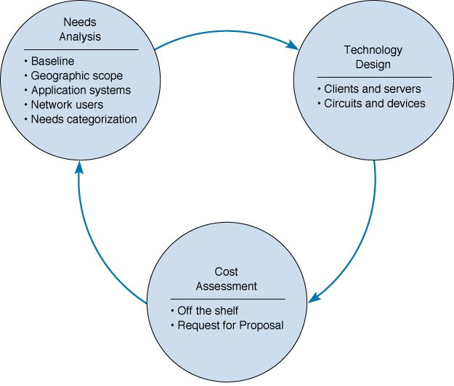
Network Design

Slide 10
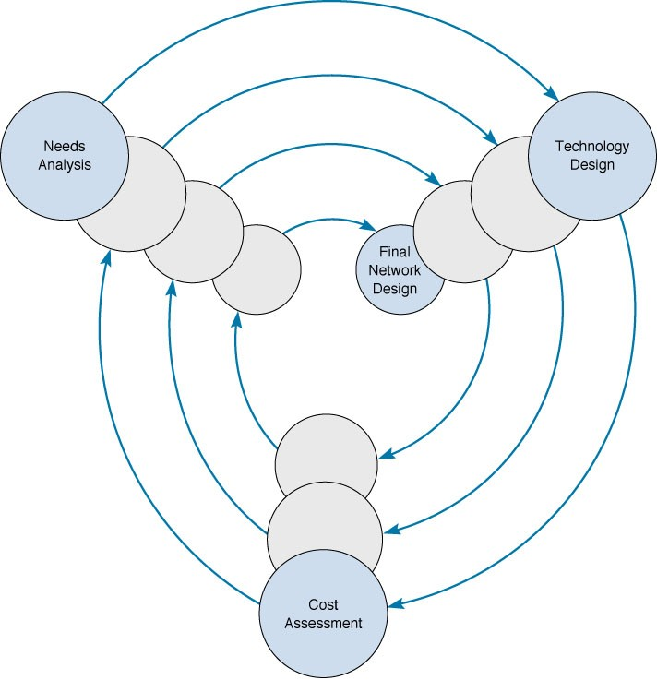
Cycle nature of network design

Slide 11
Need Analysis:
Need analysis is a critical phase in network desing ,as it forms the foundation upon which the entire network arhitecture is built.
The goal of need analysis is to understand why the network is being built and what users and application it will support. Many cases the network is design to improve poor performance or enable new applications to be used.
In other cases, the network is upgraded to replace unreliable or aging equipment or to standarize equipment so that only one type of equipment ,one protocol or one vendors equipment is used everywhere in the network.
Major phases of needs analysis phase of network design are listed below:

Slide 12
Understand Business Requirement:
Security Requirement:
Performance and bandwidth requirement
Network Infrastructure
Backup and Disaster recovery
User experience and support
Budget Constraints
Notes:
understandig business requirement: User, the type of devices. how much data to be transferred. future growth.
Security Requiremtn: Firewall , authentication method.

Slide 13
Application Systems
The designers must review the applications currently used on the network and identify their location so they can be connected to the planned network (baselining).
Next, applications expected to be added to the network are included.
It is also helpful to identify the hardware and software requirements and protocol type for each application.

Slide 14
Network Users
In the past, application systems accounted for the majority of network traffic. Today, much network traffic comes from Internet use (i.e., e-mail and WWW).
Future network upgrades will require understanding how the use of new applications, such as video, will effect network traffic.

Slide 15
Categorizing Network Needs
The next step is to assess the traffic generated in each segment, based on an estimate of the relative magnitude of network needs (i.e. typical vs. high volume). This can be problematic, but the goal is a relative understanding of network needs.
Once identified, network requirements should be organized into mandatory requirements, desirable requirements, and wish list requirements.

Slide 16
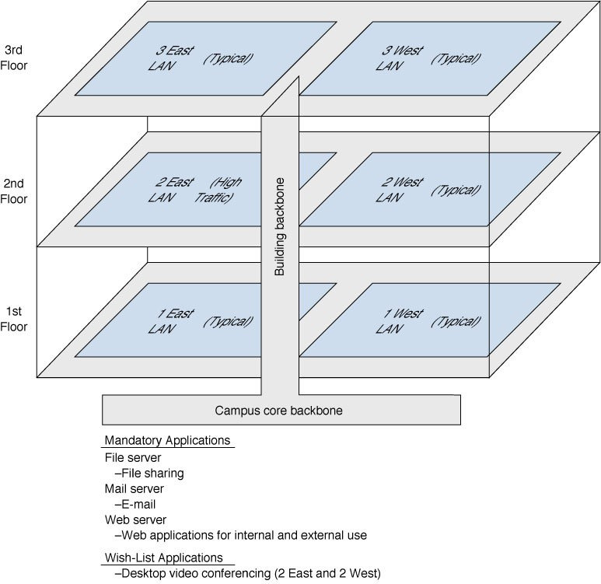
Figure 9-4 Sample needs assessment

Slide 17
Technology Design
After needs assessment has been completed, the next design phase is to develop a technology design (or set of possible designs) for the network.

Slide 18
Designing Clients and Servers
In the building block approach, the technology design is specified by using “standard” computer units:
“Typical” users are allocated “base level” client computers, as are servers supporting “typical” applications.
“High volume” users and servers are assigned “advanced” computers.
The definition for a standard unit, however, keeps changing as hardware costs continue to fall.

Slide 19
Designing Circuits and Devices
Two interrelated decisions in designing network circuits and devices are: 1) deciding on the fundamental technology and protocols and 2) choosing the capacity each circuit will operate at.
Capacity planning means estimating the size and type of the “standard” and “advanced” network circuits for each type of network.
This requires some assessment of the current and future circuit loading in terms of average vs. peak circuit traffic.

Slide 20
Network Design Tools
There are several Netwrok design tools available that is used for different aspects of network planning,simulation, and visualization.These tools are essential for network architects and engineers to design, model and alanyze network configurations.Few popular network design tools are listed below:
Cisco Packet tracer:
Cisco VIRL (Virtual Internet Routing Lab):
GNS3 (Graphical Network Simulator-3):
SolarWinds Network Configuration Manager
Wireshark
Microsoft Visio
Draw.io
Notes:
Microsoft Visio: diagraming tools, used to create network diaram
Draw.io :- online diagraming tool.

Slide 21
Deliverables
The key deliverables at this point are a revised set of network maps that include general specifications for the hardware and software required.
In most cases the crucial issue is the design of the network circuits.

Slide 22
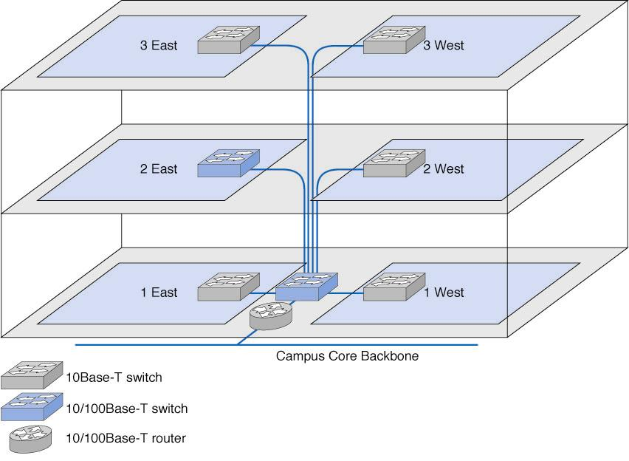
Physical Network Design

Slide 23
Cost Assessment
Cost assessment’s goal is to assess the costs of various network alternatives produced as part of technology design. Costs to consider include:
Circuit costs for both leased circuits and cabling.
Internetworking devices such as switches and routers.
Hardware costs including servers, memory, NICs & UPSs.
Software costs for operating systems, application software and middleware.
Network management costs including special hardware, software, and training.
Test and maintenance costs for monitoring equipment and supporting onsite repairs.
Operations costs to run the network.

Slide 24
Request for Proposal (RFP)
While some components can be purchased “off-the-shelf”, most organizations develop an RFP before making large network purchases.
The RFP creates a competitive environment for providing network equipment and services .
Once vendors have submitted network proposals, the organization evaluates them against specific criteria and selects the winner(s).
Multi-vendor selections have the advantage of maintaining alternative equipment and services sources, but are also more difficult to manage.

Slide 25
Figure 9-6. Request for Proposal
Background Information
Organizational profile; Overview of current network; Overview of new network; Goals of the new network
Network Requirements
Choice sets of possible network designs (hardware, software, circuits); Mandatory, desirable, and wish list items, Security and control requirements; Response time requirements; Guidelines for proposing new network designs
Service Requirements
Implementation time plan; Training courses and materials; Support services (e.g., spare parts on site); Reliability and performance guarantees
Bidding Process
Time schedule for the bidding process; Ground rules; Bid evaluation criteria; Availability of additional information
Information Required from Vendor
Vendor corporate profile; Experience with similar networks; Hardware and software benchmarks; Reference list

Slide 26
Selling the Proposal to Management
An important hurdle to clear in network design is obtaining the support of senior management.
Gaining acceptance from senior management lies in speaking their language and presenting the design in terms of easily understandable issues.
Rather than focusing on technical issues such as upgrading to gigabit Ethernet, it is better to make a business case by focusing on organizational needs and goals such as comparing the growth in network use with the growth in the network budget.

Slide 27
Deliverables
There are three key deliverables for this step:
1. An RFP issued to potential vendors.
2. After the vendor has been selected, the revised set of network maps including the final technology design, complete with selected components.
3. The business case written to support the network design, expressed in terms of business objectives.

Slide 28
Managed Network
Designing a managed netwrok for optimal performance involves careful planning, strategic decision making and ongoing maintenance.
Managed network can be managed by using manaaged devices such as Router and switches which are standard devices. these devices have small onbord computers to monitor traffic that flows through the devices.
Managed devices perform their function routing and switching and record data on the traffic they process.
A managed network requires both hardware and software managed devices to monitor, collcet and transmit traffic reports and problems alerts and netwrok management software to store, organiza and analze these reports and alerts.

Slide 29
Managed devices are more expensive than unmanaged device becaus they have CPU and software built into them.
There are three fundamentally different types of network management software:
Device management software
System management software
Application management software

Slide 30
Managed Netwrok Traffic:
Most approaches to improving network performace attempt to maximize network speed. Another approach is to manage where and how we route traffic to improve netwrok performance. Here we describe two tools designed to better manafe teaffic with the ultimate goal of improving netwrok performance.
Load Balancing:
Load balancing is the process of distributing network traffic or computing workload across multiple servers to ensure no single server is overwhelmed, thus optimizing resource utilization, maximizing throughput, and minimizing response time.
Policy-Based Management:
Policy-based management involves defining and implementing policies that dictate how resources or devices should be configured, monitored, and managed. These policies are rules or guidelines that help maintain consistency, security, and compliance within a network or system.

Slide 31
Reducing Network Traffic:
Rreducing network traffic is essential for optimizing netwrok performance, ensuring efficeint use of bandwidth, and minimizing congestion. We cant reduce all kind of traffic , but if we limit high-capacity users and move the most commonly used data closer to the users who need it, we can reduce traffic enough to have an impact on network performance. There are three different tools that can be used:
Capacity Management
Content Caching and
Content Delivery

Slide 32
Capacity Management:
Capacity management devices, sometimes called bandwidth limiter or bandwidth shapers, monitor traffic and can slow down traffic from users who consumes a lot of network capacity.
Capacit management is related to policy management but is simpler in that is only looks at the source of the traffic(i.e soure IP address) rather than the nature of the traffic(i.e. videoconferencing ,email,web). These devices are installed at key points in the network such as between ta back bone and the core network.

Slide 33
Content caching means storing frequently used web pages locally, using a cache engine.
Web requests do not go out directly, they are first shunted by the router to the cache engine to see if they are available locally.
Traffic volume is lowered since many frequently requested web sites, such as yahoo.com, can be retrieved from the cache and don’t need to go out on the Internet.
Content Delivery Another way to minimize network traffic is for web site operators to move content closer to users, called content delivery, is done by operating web servers.
If a web page of one of the content deliverers client’s is accessed, it checks if any web page components are located on a server near the requesting computer and sends those.
This benefits both the Web provider by lessening demand on its Web servers, the ISP by lowering demand on its Internet circuits, as well as decreasing Internet traffic overall.

Slide 34
Configuration Management:
Configuration management means managing the networks hardware and software configuration,documenting it, and ensuring it is updated as the configuration changes.
Configuring the Netwok and client Computers:
One of the most common configuration activities is adding and deleting user accounts. When new users are added to the network they are usually categorized as being a member of some group of users(eg, faculty, students, accounting department, personnel department). Each user group has its own access privileges, which define what file server , directories and files they can access and provide and standard login script.
Documenting the configuration
Configuration documents includes information about network hardware, network software, user and application profiles and network documentation.The most basic infromation about network hardware is a set of netwrok configuration diagrams that document the number , type and placement of network circuits,network servers , network devices and client computer.

Slide 35
Performance and fault Management
Performance management means ensuring the network is oprating as effieicntly as possible whereas fault management means preventing, detecting and correcting fault in the network circuit , hardware, and software.
Fault management and performanance management are closely related because any faults in the network reduce performance.Both require network monitoring, which means keeping track of the operation of network circuit and devices to ensure they are functioning properly and to determine how heavily they are used.
Network Monitoring
Network monitoring is a crucial aspect of managing and maintaining a computer network. It involves the continuous monitoring of network performance, traffic, and devices to identify issues, ensure optimal performance, and respond to potential problems.

Slide 36
Failure Control Function:
Fixing problems needs a plan. It doesn't matter if the Network Operation Center (NOC) sees the issue first or if users tell the NOC or a help desk about it. If the NOC or the help desk deals with network problems, there should be one phone number for users to call when something goes wrong. Only this group or someone they choose can talk to hardware or software companies for help.
Performance and Failure Statistics:

Slide 37
Improving Performance
Companies make agreements with their internet and service providers to ensure good performance. These agreements, known as Service-Level Agreements (SLAs), outline exactly what the company expects and what issues are okay. For example, an SLA might say the network should work 99% of the time, and certain parts should last at least 120 days without problems. SLAs also set the maximum time allowed to respond to issues. If the provider doesn't meet the agreement, there are rules about how they should fix it. Some companies also use SLAs inside their own teams to explain how the networking team should work with other departments.

Slide 38
End User Support
End user support involves three main functions:
Resolving Network Faults:
Fixing issues or problems with the computer network to ensure it works smoothly.
Addressing technical glitches or disruptions that may affect the overall network performance.
Resolving User Problems:
Helping users with any issues or difficulties they face while using computers or software.
Providing solutions and assistance to ensure users can work effectively without disruptions.
Training:
Providing education and guidance to end users on how to use computer systems, software, and applications.
Offering training sessions to improve user knowledge and skills in using technology.

